Slide 1
Comparison of LH₂ Storage Tank Design
Summer Internship 2022

Slide 2
Comparison based on,
“Spectral Project- Single-aisle LR H₂ airliner” -Master TAS Aero Aircraft Design 2020/2021- Report
“SWP 8: Structural Design of a Liquid Hydrogen Tank for a medium-range airliner”- Master's Research Project 2021- Report
“Application of FAST-OAD code to the conceptual design of a hydrogen-fueled commercial aircraft” – EASN Virtual Design Conference 2021- Presentation

Slide 3
“Spectral Project- Single-aisle LR H₂ airliner” -Master TAS Aero Aircraft Design 2020/2021” Report
Highlights

Slide 4
Key Points
A321 LR used as reference a/c
Boil off: 12% of fuel mass
Internal pressure: 3.5 bar
2 tanks considered and manual thermal analysis computations made
Multi-layer insulation based on polyurethane foam chosen
Trade-off with number of passengers to have an acceptable fuselage length
FAST-OAD does not consider thermal analysis
Parameter | FAST-OAD | ALCAZAR
MTOW | -5% | 13%
Tank Length | 29.3 m | 22.22 m
SFC | 0.214 kg.daN⁻¹.hr⁻¹ | 0.219 kg.daN⁻¹.hr⁻¹
Tank mass | 6729 kg | 2243 kg

Slide 5
“SWP 8: Structural Design of a Liquid Hydrogen Tank for a medium-range airliner”- Master's Research Project 2021” Report
Highlights

Slide 6
Key Points
Component | Estimated Mass (kg) | Final Mass (kg) | Difference
Bladder | 1012 | 2277 | +125%
Tank Frames & stringers | 101 | 1367 | +1253%
Interconnected truss structure | 101 | 76 | -25%
Tank mass | 1214 | 3720 | 206%
A318 used as reference a/c
Min operating pressure: 1.2 bar
Maximum pressure difference: 1.52 bar
1 tank considered and no thermal analysis computations made
Multi-layer insulation based on polyurethane foam chosen
Brewer’s integral concept used for integral tank design
2 load cases used for sizing of tank and tank components such as frames and stringers
Supporting truss structures analyzed using NASTRAN showing effects of bending and shear and not compression

Slide 7
“Application of FAST-OAD code to the conceptual design of a hydrogen-fueled commercial aircraft” – EASN Virtual Design Conference 2021” Presentation
Highlights

Slide 8
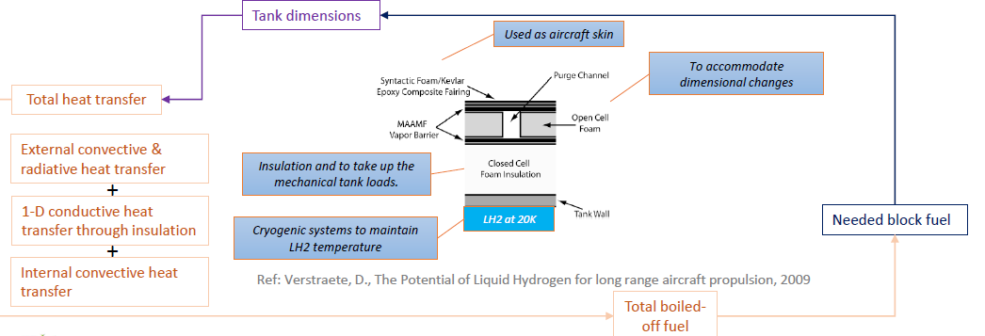
Key Points
A318 used as reference a/c
Total volume = Mission fuel + boil off+ 14.6% additional volume
Vent pressure: 3.5 bar
1 tank considered (rear) and thermal analysis computations made
Multi-layer insulation based on polyurethane foam chosen
Tank material: Aluminum (4.4 % Cu) 2014-T6

Slide 9
Comparison
LH₂ Storage Design Methodology

Slide 10
Parameter | TAS-2021 | SWP 8: 2021 | EASN 2021
Reference a/c | A321 | A318 | A318
Tank Shape | Cylindrical with hemispherical ends | Cylindrical with hemispherical ends | Cylindrical with hemispherical ends
Tank type | Integral | Integral | Integral
Number of tanks | 2 | 1 | 1
Tank Length | 18.2 m | 10.7 m | 9.79 m
Tank Height | 3.65 m | 3.64 m | 3.7 m
Tank Thickness | 1.61 mm | 3.2 mm | 3.3 mm
Tank Volume | 219.63 m³ | 108 m³ | 95 m³
Tank Material | Aluminum (4.4 % Cu) 2014-T6 | Al2219 | Aluminum (4.4 % Cu) 2014-T6

Slide 11
Parameter | TAS-2021 | SWP 8: 2021 | EASN 2021
Empty Tank Mass | 2243.36 kg | 2277 kg (3720 kg with frames, stringer and support) | 1425 kg
Tank Insulation | Multi-Layer insulation with Closed cell foam , MAAMF, Open Cell Foam and Composite | Multi-Layer insulation with Closed cell foam , MAAMF, Open Cell Foam and Composite | Multi-Layer insulation with Closed cell foam , MAAMF, Open Cell Foam and Composite
Insulation Weight | 1094.85 kg | 756 kg | 428 kg
Tank Volumetric Efficiency | - | 0.837 | -
Tank Weight Fraction | 0.598 | 0.252 | 0.291
Total Tank Mass (With Fuel) | 15583 kg | 11760 kg | 8421 kg
Support Structure for tank | No Analysis Performed | 36-point truss system | No Analysis Performed
Thermal Analysis | Performed | Not Performed | Performed

Slide 12
Remarks
SWP 8 shows good congruence to our objective of designing a storage tank for a hydrogen fueled aircraft with a strutted wing
However, no thermal analysis has been performed and all the calculations are reliant on assumptions
Using TAS 2021 and EASN 2021 as basis for performing thermal calculations, the model can be further refined
Support structures have been analyzed but show poor results under compression
Modifications to the support structures can also be made in order to ensure compliance with certification standards
Expectation: No radical changes to storage tank design are expected after performing thermal analysis for the tank and structural analysis for support structures

Slide 13
Issues
A composite structural design can also be explored
Integral tank design poses major certification issues which are quite hard to resolve
The only option would be to consider a non-integral tank design
Addition of struts to the wing and fuselage should not have a very large consequence to the physical design of the storage tank itself
However, reinforcement maybe needed in certain areas of the fuselage and performance characteristics will alter the sizing criteria of the tank

Slide 14
Proposed Plan
Scope of Summer internship
Thermal Analysis
Perform the same thermal analysis in TAS 2021 on SWP 8
Structural Analysis
Structural analysis on the support system for integral tank design
FAST OAD
Begin integration of storage tank module in FAST-OAD
Thermal Analysis
Perform the same thermal analysis in TAS 2021 on SWP 8
Structural Analysis
Structural analysis on the support system for integral tank design
FAST OAD
Begin integration of storage tank module in FAST-OAD

Slide 15
Thank You

